Slide 1
Git Basics
Abby Chou
Notes:
In this lecture we’ll be introducing Git and Github, two very important tools that you’ll be using throughout weblab (and beyond!)

Slide 2
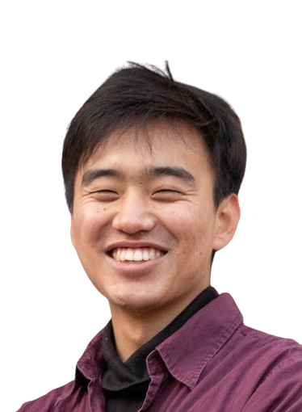
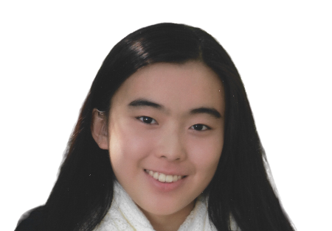

How do we collaborate on code?

Slide 3
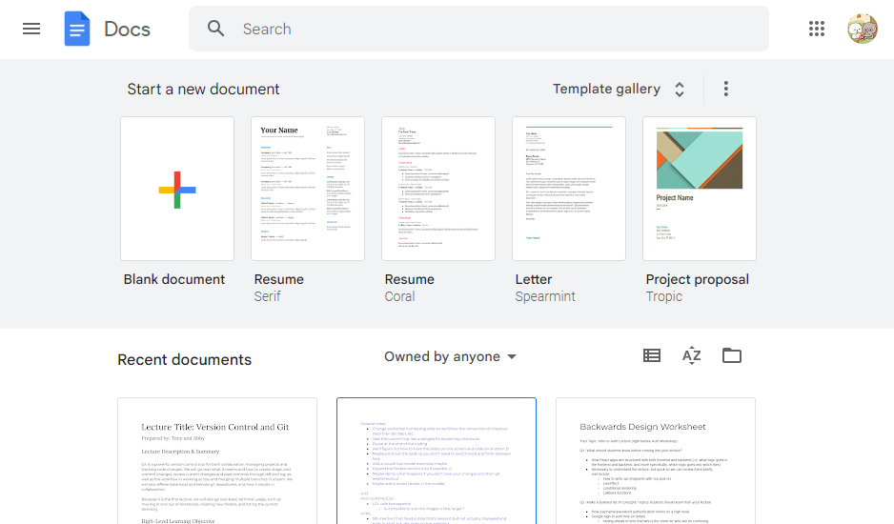
code
code
code

Slide 4


Slide 5




The issue with Code-Sharing

Slide 6
The issue with Code-Sharing
Home page
Something homepage needs

Slide 7

The issue with Code-Sharing
Home page
Something homepage needs

Slide 8
The issue with Code-Sharing
Bro what happened?
Home page
Something homepage needs

Slide 9
The issue with Code-Sharing
✨ upgrading ✨
Bro what happened?
Home page
Something homepage needs

Slide 10
The issue with Code-Sharing
Can u like not?
Home page
Something homepage needs

Slide 11
The issue with Code-Sharing
Can u like
✨deal with it✨
Can u like not?
Home page
Something homepage needs

Slide 12

We need independent copies of the code! (so people can work without disrupting each other)
Something homepage needs
Who broke xyz i need it rn >:(

Slide 13
…but that creates so many problems 😖

Slide 14



Slide 15



Slide 17
Hey I know you made changes in like 50 places in that file but can you copy the changes over one by one

Slide 18
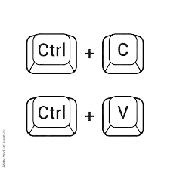

Slide 19
Remove lines 250-280
Add 24 new lines

Slide 20
An hour later...

Slide 21
WAIT!!!!!!!!!
I NEEDED LINES 250-280

Slide 22
ROLLBACK ROLLBACK
WHERE WHERE

Slide 23


Slide 24

????

Slide 25
The Problems
Need independent local copies of the codebase
Need to be able to merge different people’s changes together
Need to keep track of versions
Need to know which version is the most up-to-date

Slide 26

How do we solve these issues?
Introducing…
Notes:
And this is where Version Control comes in

Slide 27
What does Git do?

Slide 28
Git tracks changes.
(How? ✨math✨)
Notes:
By computing the difference every time you make changes

Slide 29
mydoc.txt
I’m writing a story.
It’s really good!
And about cats!
I’m writing a story.
It’s really good!
And about cats!
Like corgis :D
version1
version2

Slide 30
mydoc.txt
I’m writing a story.
It’s really good!
And about cats!
I’m writing a story.
It’s really good!
And about cats!
Like corgis :D
I’m writing a story.
It’s really good!
And about cats!
Like corgis :D
version1
version2
version3

Slide 31
mydoc.txt
I’m writing a story.
It’s really good!
And about cats!
I’m writing a story.
It’s really good!
And about cats!
Like corgis :D
I’m writing a story.
It’s really good!
And about cats!
Like corgis :D
version1
version2
version3
The “Math”:
+ Like corgis :D
@ Line 4
- And about cats!
@ Line 3

Slide 32
example
Getting set up with git :D

Slide 33
Demonstration
Try the following:
Make a new directory
Cd into that directory
Turn your directory into a git repo!
Reference
cd [directory] change directory
ls list the contents of current directory
mkdir [folder_name] make directory
git init turns current directory into git repo!
Special Characters:
. current directory
.. parent directory

Slide 34
Your turn!
Try the following:
Make a new directory
Cd into that directory
Turn your directory into a git repo!
Reference
cd [directory] change directory
ls list the contents of current directory
mkdir [folder_name] make directory
git init turns current directory into git repo!
Special Characters:
. current directory
.. parent directory
Notes:
Raise your hand if you need more time

Slide 35
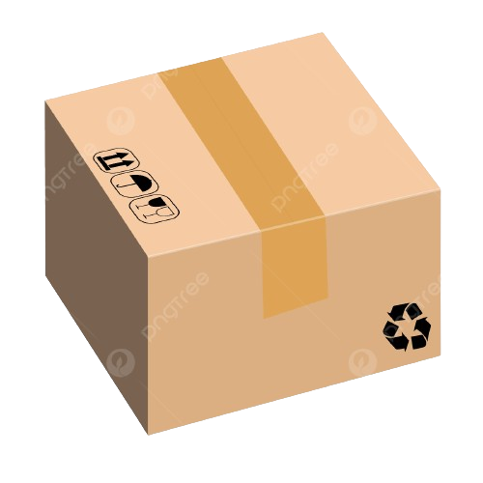

Staging & Committing
- I like cats :D
cats.py line 4
+ I like corgis :D
woof.py line 37
Doing stuff
time
+ I like huskies :D
woof.py line 27
Added stuff
+ I like Andrew :D
tonythoughts.js line 24
Started stuff
Working copy
Staging Area
Commit History
Notes:
I have a working copy of the code in my working directory

Slide 36
Staging & Committing
Working copy
Notes:
I have a working copy of the code in my working directory

Slide 37
Staging & Committing
- I like cats :D
cats.py line 4
+ I like corgis :D
woof.py line 37
Notes:
I have a working copy of the code in my working directory

Slide 38
Staging & Committing
- I like cats :D
cats.py line 4
+ I like corgis :D
woof.py line 37
+ I like huskies :D
woof.py line 27
Notes:
I have a working copy of the code in my working directory

Slide 39
Staging & Committing
- I like cats :D
cats.py line 4
+ I like corgis :D
woof.py line 37
+ I like huskies :D
woof.py line 27
- if the plural of mouse is mice then why is the plural of house houses
showerthoughts.js line 24
Notes:
I have a working copy of the code in my working directory

Slide 40
Staging & Committing
- I like cats :D
cats.py line 4
+ I like corgis :D
woof.py line 37
Doing stuff
time
+ I like huskies :D
woof.py line 27
Added stuff
- if the plural of mouse is mice then why is the plural of house houses
showerthoughts.js line 24
Started stuff
Working copy
Commit History
Notes:
I have a working copy of the code in my working directory

Slide 41
Staging & Committing
git add <filepath>
- I like cats :D
cats.py line 4
+ I like corgis :D
woof.py line 37
Doing stuff
time
+ I like huskies :D
woof.py line 27
Added stuff
- if the plural of mouse is mice then why is the plural of house houses
showerthoughts.js line 24
Started stuff
Working copy
Staging Area
Commit History
Notes:
I have a working copy of the code in my working directory

Slide 42
Staging & Committing
git add woof.py
- I like cats :D
cats.py line 4
+ I like huskies :D
woof.py line 27
Doing stuff
+ I like corgis :D
woof.py line 37
time
Added stuff
- if the plural of mouse is mice then why is the plural of house houses
showerthoughts.js line 24
Started stuff
Working copy
Staging Area
Commit History
Notes:
I have a working copy of the code in my working directory

Slide 43
Staging & Committing
git add cats.py
- I like cats :D
cats.py line 4
+ I like huskies :D
woof.py line 27
Doing stuff
+ I like corgis :D
woof.py line 37
time
Added stuff
- if the plural of mouse is mice then why is the plural of house houses
showerthoughts.js line 24
Started stuff
Working copy
Staging Area
Commit History
Notes:
I have a working copy of the code in my working directory

Slide 44
Staging & Committing
git commit -m <commit msg>
+ I like corgis :D
woof.py line 37
+ I like huskies :D
woof.py line 27
Doing stuff
time
Added stuff
- if the plural of mouse is mice then why is the plural of house houses
showerthoughts.js line 24
Started stuff
Working copy
Staging Area
Commit History
Notes:
I have a working copy of the code in my working directory

Slide 45
Staging & Committing
git commit -m “dogs and cats”
+ I like corgis :D
woof.py line 37
+ I like huskies :D
woof.py line 27
Doing stuff
time
Added stuff
- if the plural of mouse is mice then why is the plural of house houses
showerthoughts.js line 24
Started stuff
Working copy
Staging Area
Commit History
Notes:
I have a working copy of the code in my working directory

Slide 46
Staging & Committing
Dogs and cats
Doing stuff
time
Added stuff
- if the plural of mouse is mice then why is the plural of house houses
showerthoughts.js line 24
Started stuff
Working copy
Staging Area
Commit History
Notes:
I have a working copy of the code in my working directory

Slide 47
Staging & Committing
Dogs and cats
Doing stuff
time
Added stuff
- if the plural of mouse is mice then why is the plural of house houses
showerthoughts.js line 24
Started stuff
Working copy
Staging Area
Commit History
Notes:
I have a working copy of the code in my working directory

Slide 48
Demo Staging & Commits
Demonstration
Make some changes
Git status
Stage some changes
Git status
Make a commit
Git status
Git log
Git status
git diff
git status
git add
git commit -m

Slide 49
Your turn!
In your new repo…
Make some code changes
Stage changes with git add
Commit the changes
Check your commit log
(Optional) Repeat! (Try deleting stuff too)
After you make changes (before you stage them), git diff to see your changes!
Commands Ref
git add stage changes for commit
git commit -m “[msg]”
git status <- use this often!
git log show commit history
git diff show the diff (changes) between working copy and staged/committed copy
Notes:
5 minutes ?

Slide 50
Object Graph
18e3
dogs
Commit id: 18e3
Message: “dogs”
Dogs and cats
33cc
time
Doing stuff
8e33
Added stuff
ca53
Started stuff

Slide 52
Uh oh, my boss is madge
tony: “vibing working on my new and improved home page ”

Slide 53

Uh oh, my boss is madge
tony: “vibing working on my new and improved home page ”
andrew: “can u help me fix this bug on the home page”
👉👈

Slide 54
Uh oh, my boss is madge
tony: “vibing working on my new and improved home page ”
andrew: “can u help me fix this bug on the home page uwu”
tony: “i gotchu bro”
👉👈
👉👈

Slide 55
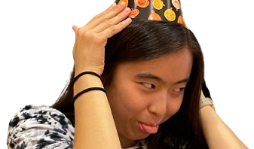
Uh oh, my boss is madge
tony: “vibing working on my new and improved home page ”
andrew: “can u help me fix this bug on the home page”
tony: “i gotchu bro”
boss abby (who got dumped recently 😒) : “tony we need a
weblab-tinder feature TOMORROW and u hav to do it”
😅
😅

Slide 56
Uh oh, my boss is madge
tony: “vibing working on my new and improved home page ”
andrew: “can u help me fix this bug on the home page”
tony: “i gotchu bro”
boss abby (who got dumped recently 😒) : “tony we need a
weblab-tinder feature TOMORROW and u hav to do it”

Slide 57

Uh oh, my boss is madge
tony: “vibing working on my new and improved home page ”
andrew: “can u help me fix this bug on the home page”
tony: “i gotchu bro”
boss abby (who got dumped recently 😒) : “tony we need a
weblab-tinder feature TOMORROW and u hav to do it”
tony: “bruh”
How do we work on multiple features at once?
save me ☹️

Slide 58
Branching
home
page remodel
weblab tinder
Andrew bug fix
Tony home
page
Last home
page
Other stuff

Slide 59
Demo Branches
Demonstration
Creating a new branch
Switching between branches

Slide 60
Your turn!
Handy commands
git branch see branches
git checkout [branch-name]
switch to existing branch
git checkout -b [branch-name]
create and checkout new branch
Previous Commands
git status
git add
git commit -m
git log
In your new directory…
Create a new branch
Add a couple of commits to your branch, check the log
Checkout back to main, check the log
Add a couple of commits to main, check the log
Try and draw and/or explain to your partner what you think the object graph looks like!
Notes:
5 minutes (?)

Slide 61
What is happening in the object graph :0?
webtinder
main

Slide 62
How do we put them back together?
webtinder
main

Slide 63
example
merging

Slide 64
Follow Along
Follow along!
Checkout into main branch
Git merge [new branch name]

Slide 65
How do we put them back together?
webtinder
main

Slide 66
How do we put them back together?
Sort of..
webtinder
webtinder
main
main

Slide 67
How do we put them back together?
Fast forwarding actually looks like this, idk if it would be a good example hm
Sort of..
webtinder
webtinder
webtinder
main
main
main

Slide 68
Preview
🐳, how does collaboration work then?
Notes:
All of that was on our computer :’)

Slide 69

webtinder
main
webtinder
main
Remote Server (github)

Slide 70
git clone
webtinder
webtinder
main
webtinder
main
main
Remote Server (github)

Slide 71
git commit
webtinder
webtinder
main
main
webtinder
main
Remote Server (github)

Slide 72
git push
webtinder
webtinder
main
main
webtinder
main
Remote Server (github)

Slide 73
Git fetch
webtinder
webtinder
main
main
webtinder
main
Remote Server (github)

Slide 74
Git fetch
webtinder
webtinder
main
main
webtinder
main
Remote Server (github)

Slide 75
Git fetch
webtinder
webtinder
main
main
webtinder
main
Remote Server (github)

Slide 76
Git fetch
webtinder
webtinder
main
main
webtinder
main
Remote Server (github)

Slide 77
webtinder
webtinder
main
main
webtinder
main
Remote Server (github)
👍

Slide 78
git pull
webtinder
webtinder
webtinder
main
main
main
Remote Server (github)

Slide 79


Stay tuned!
+ Like cats :D
@ Line 4
Added lots of corgis to corgis.py
+ Like corgis :D
@ Line 4
+ Like corgis :D
@ Line 4
git reset - -hard
Staging area

Slide 80
Feedback Time!
weblab.is/feedback

